Slide 1
Nik Molnar  nikmd23
WHOPPER.Js
Notes:
Intro myself.

Slide 2

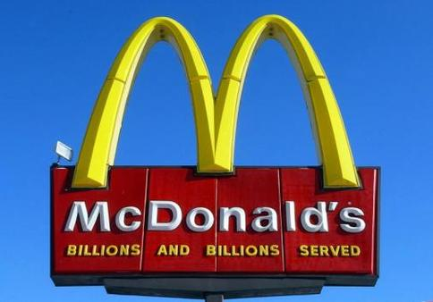
Npm:
508,474
GitHub:
1,604,219
Notes:
http://www.modulecounts.com/
We’re here today to talk about the whopper that is JS. It’s huge with 508 thousand NPM packages (for comparison, NuGet has 90K) and nearly 500 news ones added everyday.
https://octoverse.github.com/
On GitHub there are were 1.6 million pull requests that used JS last year alone.
McDonalds billions and billions sold: https://www.youtube.com/watch?v=KzOSkO8BZFw

Slide 3
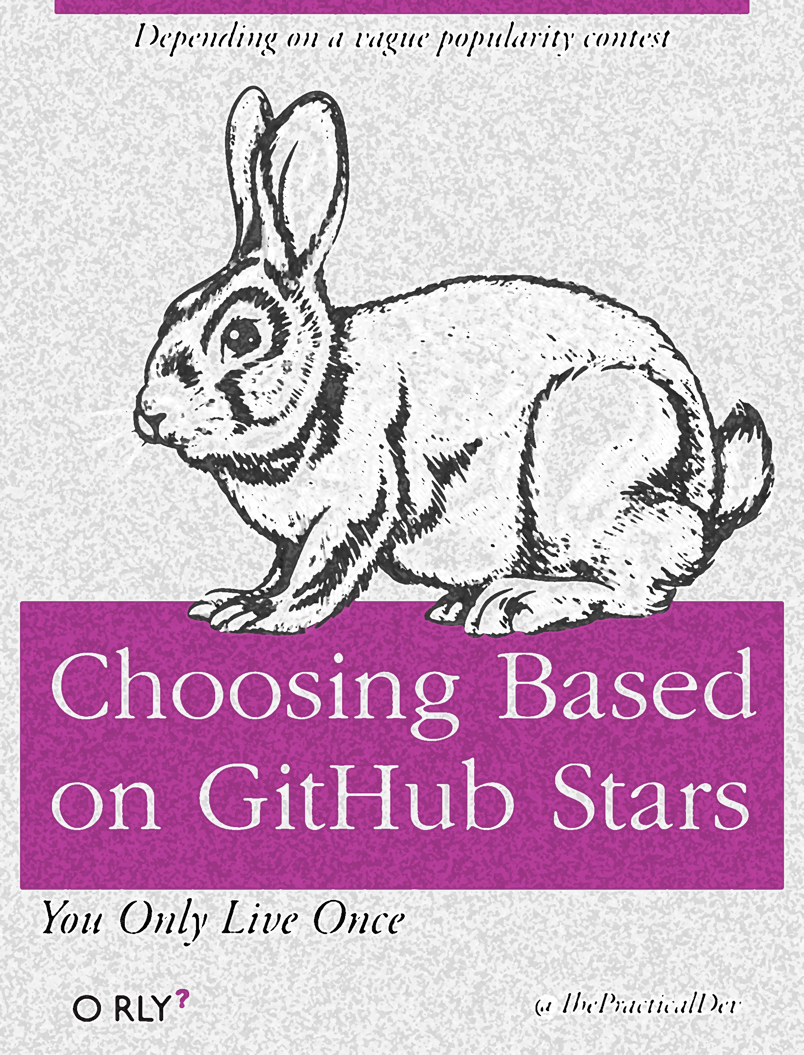


Notes:
It can all be a little overwhelming.
Making you fluent in things like “Choosing Based on GitHub Stars”, or the other popular method which is “Doing whatever Dan Abramov says to do”.
And no matter how fluent you are in those approaches, it still seems like you need to understand ho to “rewrite your front end every six weeks” in the real world.

Slide 4
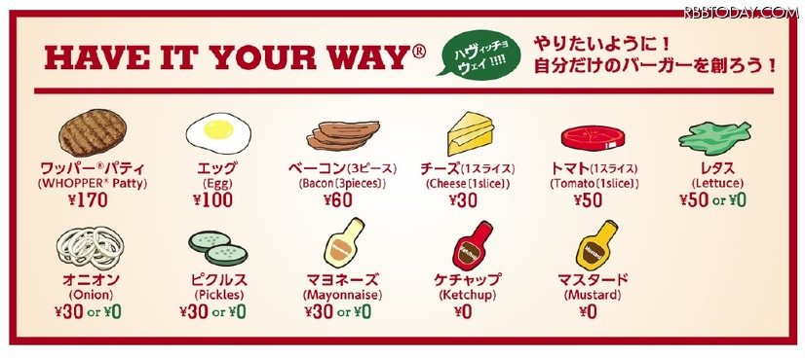
Notes:
But hey, all of that choice is a great benefit. You can have it your way by.
Get just the pieces you want, prepared the way you want, nothing more, nothing less.

Slide 5
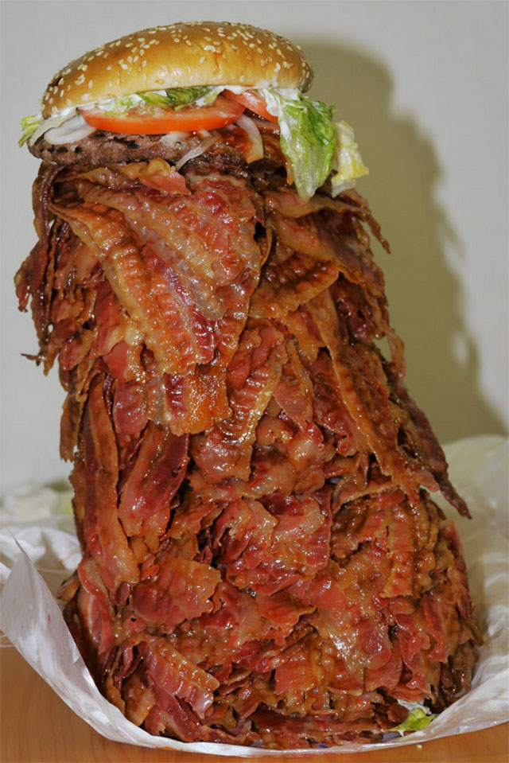
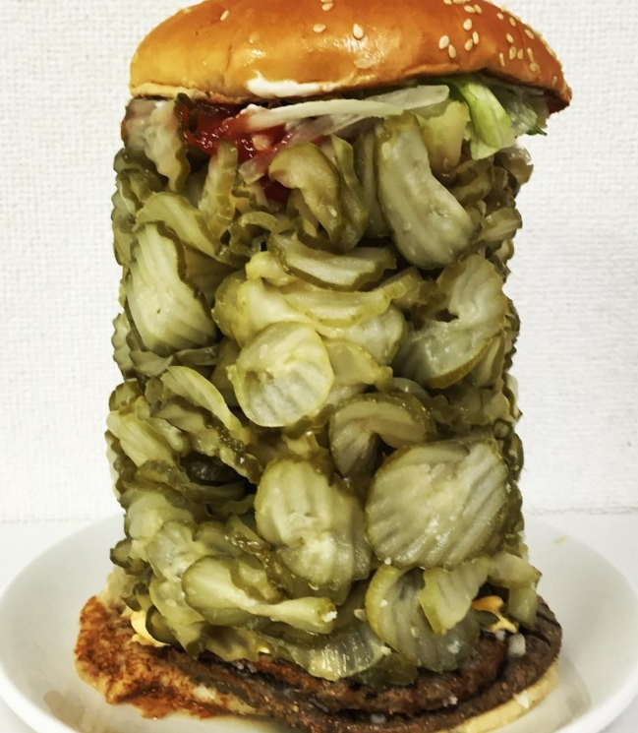
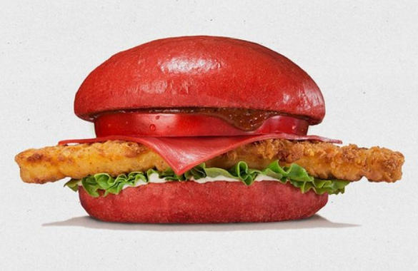
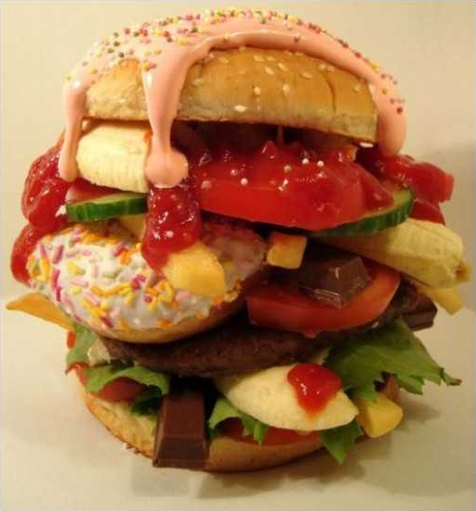
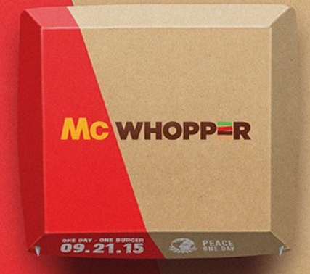
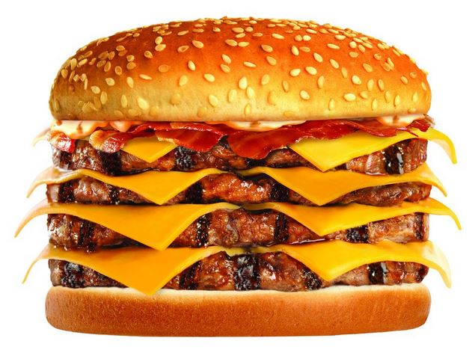
Notes:
And when you do that, you can create sensible applications.
Sometimes they’re a little indulgent.
Or maybe you end up using something that’s really just a gimmick and is completely unnecessary – but it seems fun.
I’ve seen teams who literally download the entirety of NPM to put together their application.
And others who lean way too heavily on one feature to the point that it’s really unhealthy.
This is actually quite common
And my favorite, it the frankensteins apps that use both react and angular for “Reasons”

Slide 6
Notes:
But hey, you get to have it your way.
Let me show you some of the ways that I like to have things.

Slide 7

Hadouken
Notes:
Maybe you don’t need all that wiz-bang stuff. You already have the functionality written, so reuse it! It’s my way because I’m lazy.

Slide 8

Serverless
Notes:
Have it your way: Developer friendly. It’s my way because Everythings in source control. Easy to manipulate on CLI

Slide 9
Hotel
FAAS
Rent Room
PAAS
Own House
IAAS
Notes:
Serverless is a state of mind, not so much a physical reality.
Talk about the differences, why FAAS, how docker compares, etc.
https://www.hanselman.com/blog/IntroducingWindowsAzureWebJobs.aspx

Slide 10

Nik Molnar  nikmd23
WHOPPER.Js

Slide 11
OUTLINE
JS is everywhere and awesome
You should be able to have it, and have it your way
The ecosystem provides a lot of options
Jokes about noun.js
Interoperability is important in case you choose the wrong thing, or you project changes
That means you might make something weird
Crazy burger creations
That’s the beauty of it
Interoperability
Hosting like Cattle Farmer, Home Cook, Burger King for On-Prem, IaaS, PaaS
Docker is an example of this
Functions as a Service is another

Slide 12

Notes:
https://www.youtube.com/watch?v=d7LsJ0KSlh8
They are working on provider independent serverless functions

Slide 13
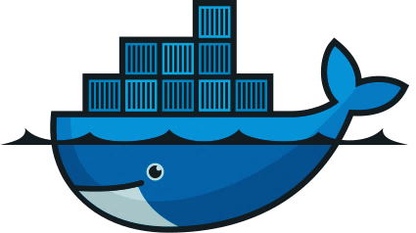
docker
Notes:
I’m at BurgerKing. I don’t want to have to worry about scalability.
This is where FaaS comes in

